Slide 1



Promoting the Participation of Persons with Disabilities in Elections in
Ecuador through Citizen Journalism
Diana Andrade
The Trust for the Americas – Fundación para las Américas
September 23, 2014, Mexico City

Slide 2
PROJECT FRAMEWORK
NGO based in Washington DC, United States, with projects in approximately 15 Latin American countries.
2004 > Partnership in Opportunities for Employment through Technology in the Americas – POETA ACCESIBLE (Technology Centers- Disability)
2012-2013 > Ecuador
Promoting the Participation of Persons with Disabilities in Elections in Ecuador through Citizen Journalism
  Training in Citizen Journalism
    100 persons with disabilities + organizations of and for them
    6 cities: Quito, Ibarra, Cuenca, Loja, Guayaquil, and Machala
    9 training units(72 hours)
    20 communication products(video, audio, photo, and media)
    Donated equipment: laptop, camera, and recorder.
  Partnership with National Electoral Council (CNE)
    Web Accessibility seminar for officials and advisory services: staff in the whole country.
    Lectures for citizen reporters
    Sharing of data and resources

Slide 3
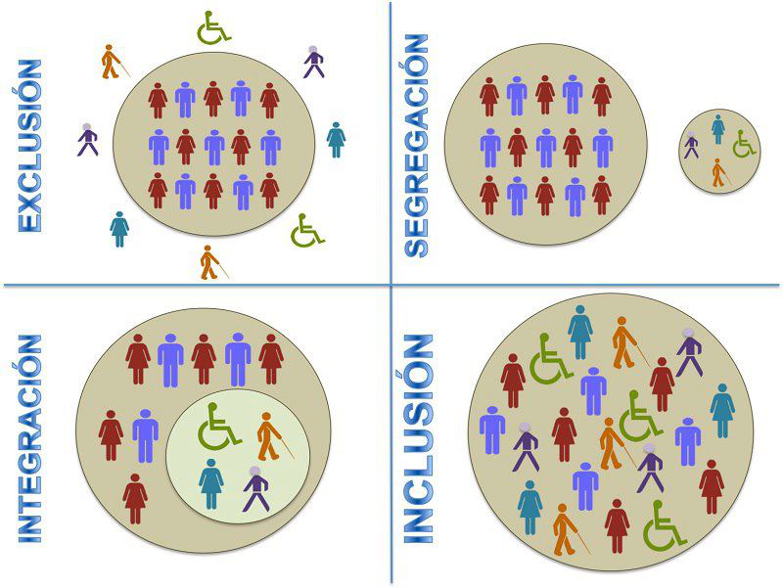
Human Rights – Disabilities Focus
OAS (1999) – Inter-American Convention for the Elimination of All Forms of Discrimination against Persons with Disabilities
UN (2006) - Convention on the Rights of Persons with Disabilities
Medical Model = illness (assistance / charity) VS.
Social Model = context / environment (RIGHTS) – HUMAN DIVERSITY
“Nothing about us without us”

Slide 4
CITIZEN JOURNALISM
“Participation of users as information generators, transformed into creators of their own (citizen) media.”
Former passive audience = active: users inform each other (global – local) = technological tools (Internet).
Democracy = well-informed citizens express and debate opinions, educated to decide for themselves.
Journalism: intermediary between the citizen and the state, preceding and enabling constitutional democracies.
Challenges:
  Traditional journalists: networks of sources, communities of citizens, reporters, and commentators.
  Digital gap (access) – 5000 million mobile telephones.
  Verification of the information, multiple perspectives, contextualization.

Slide 5
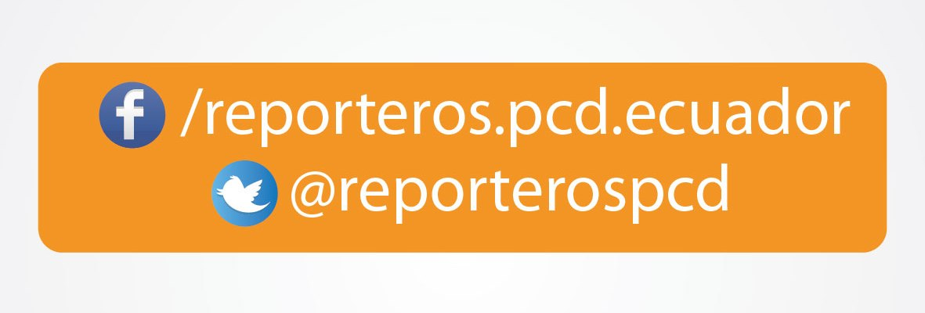








PROJECT RESULTS
COMMUNICATION PRODUCTS
www.youtube.com/ECreporterosPCD
CURRICULUM – TRAINER’S AND PARTICIPANT’S GUIDE
http://reporterospcd.fundacionparalasamericas.org/index.php/capacitacion

Slide 6
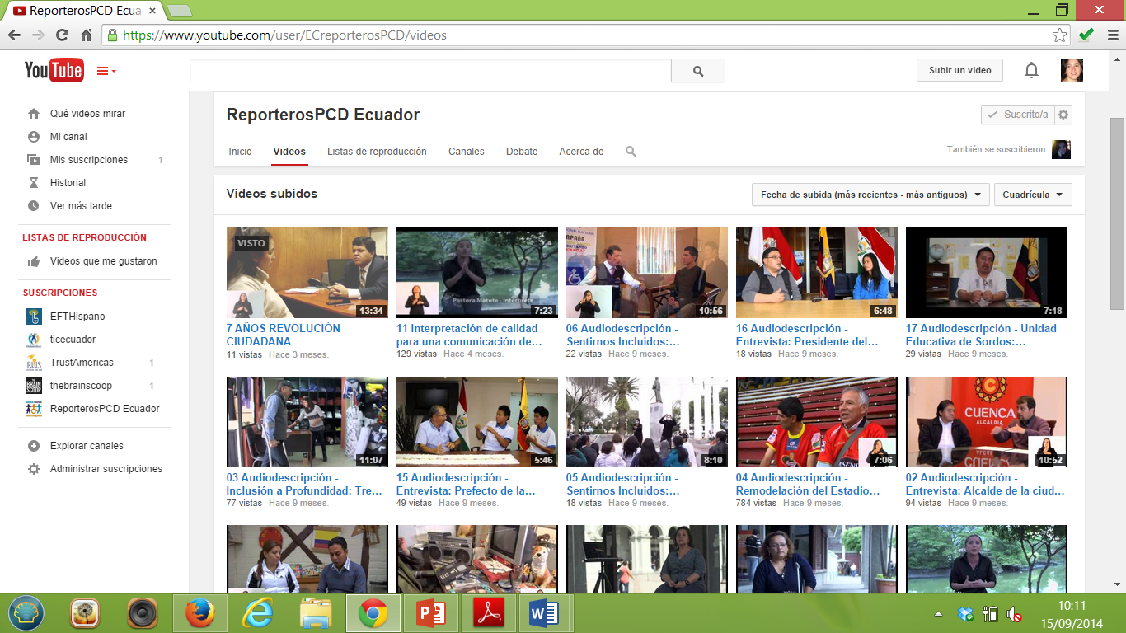
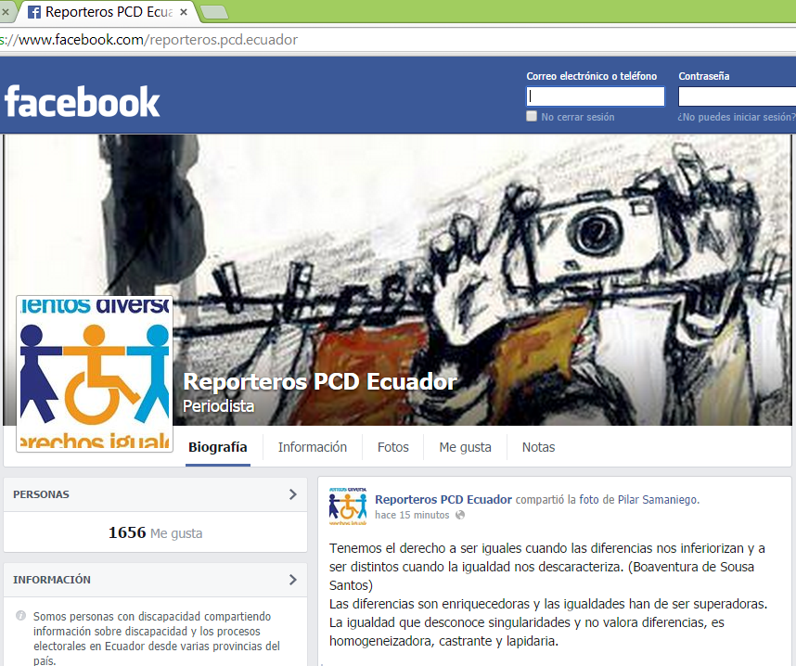
1656 Fan page
272 Facebook Group
670 Twitter
#periodismoinclusivo

Slide 7
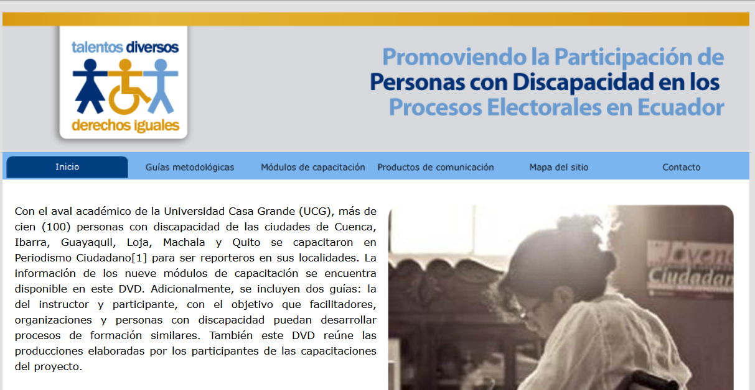
TRAINING UNITS
Academic guarantee (certification) Casa Grande University
Distribution of 600 DVDs in Ecuador to media and disability groups
Curriculum Plan: 50 POETA Technological Centers
Large-scale training at the national level: awareness building and training on disabilities (networks with 12,000 followers)
Critical thinking
Human rights and disability
Electoral processes
Language
Journalistic gender
Photography
Radio
Video
Digital journalism
Trainer’s Guide
Participant’s Guide

Slide 8
PRODUCTOS DE COMUNICACIÓN
7 years of citizen revolution, the citizens’ view of the last government
https://www.youtube.com/watch?v=P8WdheIqBTI
Feeling ourselves included: communication and electoral participation https://www.youtube.com/watch?v=uPye7jAOHAI
Feeling ourselves included : communication for life and social participation https://www.youtube.com/watch?v=DYLuK2eoxiw
Interview: Governor of Imbabura Province https://www.youtube.com/watch?v=p6hvQGu2WmM
Yes, I can participate https://www.youtube.com/watch?v=KtAhv7YE3fs
President of the Provincial Electoral Council of Imbabura https://www.youtube.com/watch?v=WE2luQYWjzA
Interview: Mayor of the City of Cuenca https://www.youtube.com/watch?v=t5dcHmtSzdg
Audio - Experience of participation of persons with disabilities in the electoral process https://www.youtube.com/watch?v=bwDjmV3mpec
Audio - Importance of participation of visually handicapped persons in electoral processes https://www.youtube.com/watch?v=6HObhHsPqE8

Slide 9
LESSONS LEARNED
Disability: social model and human rights paradigm, multiple stakeholders with different perspectives with a charity approach; it is vital to generate a continuing dialogue.
Inclusion: Great need for real social, educational, and economic inclusion (prejudices / stereotypes).
    Address these themes together in a way that complements the strengthening of citizen participation.
Citizenship: strengthening from and with social stakeholders.
Human development: strengthen leadership (self-esteem and self-confidence)
Information and Communication: significant changes with great support of technological advances: citizen journalism
Accessibility: great challenges in access to information and much more to produce it (social networks: great potential – versions for mobile devices)

Slide 10
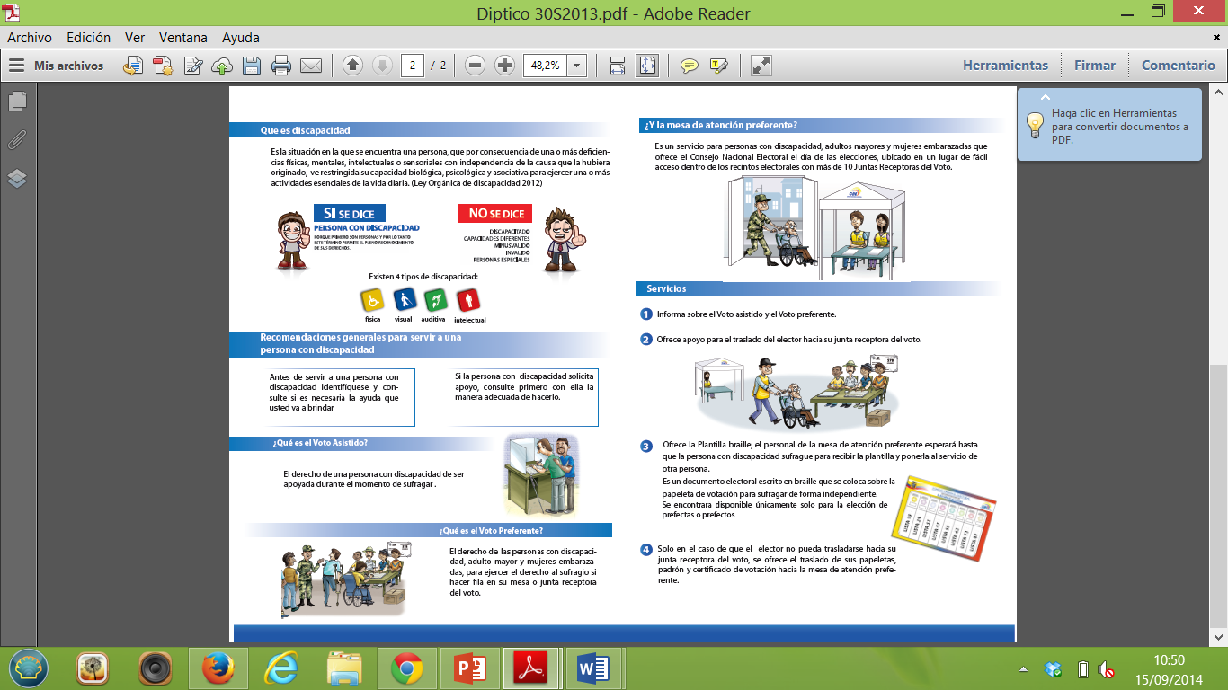

LESSONS LEARNED
CNE IN Ecuador: promote the human rights approach of disabilities
with preparation of material and emphasize proper use of language.
Challenges: synchronization of times
CNE – Report on Political Participation of Persons with Disabilities- 2014

Slide 11

  THANK YOU
Diana Andrade
dandrade@fundacionparalasamericas.org
www.fundacionparalasamericas.org

